Slide 1

Vibrational SCF and Correlation Theories with Optimized Coordinates
Kiyoshi Yagi
Theoretical Molecular Science Lab.
RIKEN Cluster of Pioneering Research

Slide 2
Vibrational Structure Theory
Molecular Hamiltonian and Schrödinger equation
Born-Oppenheimer approx.
Vibrational Schrödinger equation
In practice, we choose a set of coordinates
to represent the vibrational SE.

Slide 3
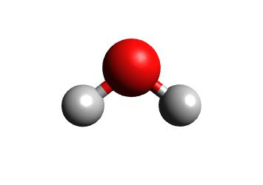
Normal Coordinates
Obtained by diagonalizing the mass-weighted Hessian
x₂
V = c₁₁ x₁² + c₂₂ x₂² + c₁₂ x₁x₂
Q₂
Q₁
V = c’₁₁ Q₁² + c’₂₂ Q₂²
x₁
(ex) Normal coordinates of a water molecule
Normal coordinates tend to be delocalized
x₂
V = c₁₁ x₁² + c₂₂ x₂² + c₁₂ x₁x₂
with c₁₁ ≈ c₂₂ >> c₁₂
Q₂
Q₁
HO-(CH₂)_{n}-OH
HO-(CH₂)_{n}-OH
x₁
V = c’₁₁ Q₁² + c’₂₂ Q₂²
HO-(CH₂)_{n}-OH
HO-(CH₂)_{n}-OH

Slide 4
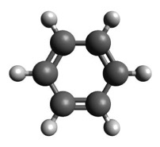
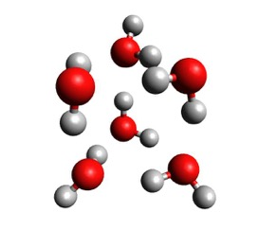

Normal vs Local modes
Local XH stretching modes
Henry (1977)
Child & Halonen (1984)
Local monomer model
Wang & Bowman (2010)
Localized mode
Jacob & Reiher (2009)
However, there is no guarantee that local is better than normal...
What is the mathematical definition of “good” coordinates?
How can we frame the physical ground?

Slide 5
Optimized-Coordinate Vibrational SCF
Thompson & Truhlar (1982); Bačić, Gerber & Ratner (1986); Bowman, Zuniga, Wierzbicki (1988)
Yagi, Keçeli & Hirata (2012)
VSCF wavefunction:
VSCF equation:
: modal coefficients
: transformation matrix
✔ Harmonic potential
Normal coordinates
✔ Non-interacting systems
Local coordinates

Slide 6
Jacobi Sweep Algorithm
Yagi, Keçeli & Hirata (2012), Yagi & Otaki (2014),
Thomsen, Yagi & Christiansen (2014).
Successive 2x2 rotations:
Selection of pairs:
Loop over sweep
Loop over mode pairs : in parallel
Numerically find the best θ_{ij}
End loop
check convergence
End of sweep
θ_{ij}
Total # of VSCF calc. =

Slide 7
Invariance of the Hamiltonian
Yagi, Keçeli & Hirata (2012)
E^{VSCF}
E^{exact}
U
nMR expansion
Taylor expansion

Slide 8
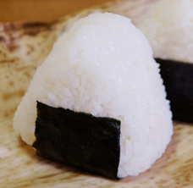
Water
normal
Harmonic
/ a.u.
Onigiri
/ a.u.
Notes:
Let us first see optimized coordinates of a water molecule.
As you know, the normal coordinates of water is symmetric and anti-symmetric OH stretching vibration.
We can geometrically understand these coordinates from this figure.
This oval in black is the harmonic potential. The normal coordinates, Q2 and Q3, takes the principal axes of the oval, making the cross term zero.
However, the anharmonic potential (quartic force field) looks like this for this cross section.
The optimization with QFF rotates the coordinates by 45 degrees and gives the local OH stretching modes.
It has been extensively discussed in the late 80’s by Mark Child/Halonen that local modes describes the vibration of water better than the normal modes.
So, it’s not too surprising that the coordinates become localized.
What’s surprising, in my opinion, is that we started from a completely different theoretical basis, we didn’t even intend to localize, and still reached at the same conclusion.
That’s the fascinating / amazing aspect of this method.

Slide 9
Water
normal
Variationally minimize
the VSCF energy
optimized
Child & Halonen, (1984)
Jensen, (2000)
Quartic
/ a.u.
Onigiri
/ a.u.
Notes:
Let us first see optimized coordinates of a water molecule.
As you know, the normal coordinates of water is symmetric and anti-symmetric OH stretching vibration.
We can geometrically understand these coordinates from this figure.
This oval in black is the harmonic potential. The normal coordinates, Q2 and Q3, takes the principal axes of the oval, making the cross term zero.
However, the anharmonic potential (quartic force field) looks like this for this cross section.
The optimization with QFF rotates the coordinates by 45 degrees and gives the local OH stretching modes.
It has been extensively discussed in the late 80’s by Mark Child/Halonen that local modes describes the vibration of water better than the normal modes.
So, it’s not too surprising that the coordinates become localized.
What’s surprising, in my opinion, is that we started from a completely different theoretical basis, we didn’t even intend to localize, and still reached at the same conclusion.
That’s the fascinating / amazing aspect of this method.

Slide 10
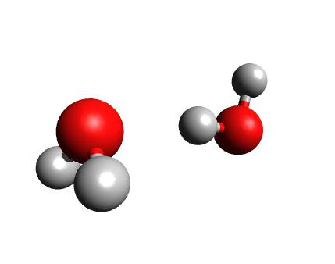
Water dimer
Normal coordinates
W2
W2
weight
W1
W1
: 3783 cm⁻¹
: 3836 cm⁻¹
mode number
bend
OH stretch
Optimized coordinates
W2
W2
weight
W1
W1
: 3807 cm⁻¹
: 3892 cm⁻¹
mode number

Slide 11
Water trimer and hexamer
Normal coordinates
Normal coordinates
weight
weight
mode number
mode number
Optimized coordinates
Optimized coordinates
weight
weight
mode number
mode number
Intramolecular vibration is localized to each water molecule

Slide 12
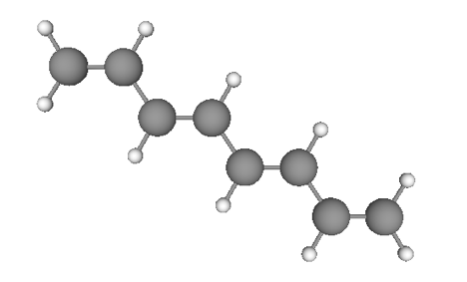
Octatetraene
weight
F4
mode number
F3
F2
F1
weight
mode number
C-H and C=C stretch are localized,
yet the scheletal vibration remain delocalized.

Slide 13
On the concept of vibrational modes
The term, “vibrational modes”, is used without discreminating:
The representative molecular motion
= separability of the system
The assignment of the vibrational bands
= character of the eigenstates
In the harmonic potential, normal coordinates satisfy these two.
oc-VSCF enhance the separability of the system, but does not necessarily characterize the eigenstates.
Therefore, the correlation levels of calculations is necessary
for quantinative purposes.

Slide 14
Optimized Coordinate
Vibrational Self-consistent Field Method
(oc-VSCF)
Vibrational correlation theories
with optimized coordinates
Summary and Outlook

Slide 15
Quantum Many-Body Theories
CC[n]-PT[n+1]
Perturbation
Theory
(PT)
Coupled Cluster
Theory
(CC)
0th order
(SCF)
QDPT
LR-CC
Configuration
Interaction
(CI)
Many-body expansion starting from the oc-VSCF solution

Slide 16
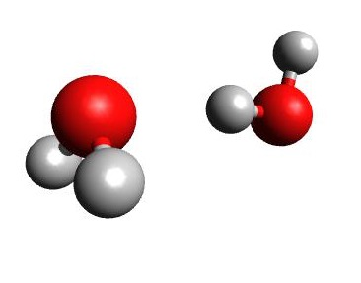
oc-VCI applied to water dimer
Yagi, Keçeli & Hirata, JCP (2012)
nc-VCI
Error of the fundamentals
(cm⁻¹)
water dimer
oc-VCI
VSCF
VCI[1]
VCI[2]
VCI[3]
VCI[4]
oc-VCI is 30,000 times faster than nc-VCI
Notes:
We’ve carried out VCI with normal and optimized coordinates, and compared their performance.
These plots in red and blue show the average error of the fundamentals. The red is VCI with optimized coordinates and the blue with normal coordinates.
We can see that the error is much reduced already at the VSCF level, and that oc-VCI is more accurate than nc-VCI in every rank.
In order to achieve 10 cm-1 accuracy, which is the typically required accuracy, VCI[3] is needed for nc-VCI, while VCI[1] already sufficient for oc-VCI.
This means that oc-VCI is 30,000 times faster than nc-VCI for water dimer, so it’s a substantial gain.

Slide 17
Force constants
units in cm⁻¹
Q_{s}
Q_{t}

Slide 18
Force constants
units in cm⁻¹
Q_{s}
Q_{t}
Q_{s}
Q_{t}
The reduction of anharmonic coupling enhances the quality of VSCF wavefunction

Slide 19
Vibrational Quasi-Degenerate PT
Yagi, Hirata, Hirao, PCCP (2008).
Non-static (dynamic) correlations：
Interaction between configurations with small λ_{pq}.
Perturbative treatment
Excited state
Static correlations：
Strong interaction due to resonance
Ground state
(Zero-point)
Variational treatment
The two types of correlations are incorporated in a balanced way
Notes:
So, the key idea is that there are two types of correlations that act on ..
The first is the static correlation. This is a strong interaction due to resonance, and requires a variational treatment.
The other one is a non-static or dynamic correlation which is dictated by dpq. In this case, each interaction is small, but there are enormous number of configurations that enter through this scheme.
We treat this interaction by perturbation theory.

Slide 20
Quasi-degenerate PT
B. Kirtman, J. Chem. Phys. 49, 3890 (1968).
I. Shavitt and L. T. Redmon, J. Chem. Phys. 73, 5711 (1980).
CI
PT
The effective Hamiltonian:
PQ
P
QP
H
→ Diagonalization of yeilds the energy and wave function.
→ In case of no-degeneracy,
(PT2)
P and Q space is efficiently constructed based on λ_{pq}
Notes:
The theory is established long time ago by Kirtman, Shavitt, Redmon.
I will not go into the details, but let me just mention that it’s a multireference PT

Slide 21
oc-VQDPT2
Yagi & Otaki (2014).
Error from VCI / cm⁻¹
Error from VCI / cm⁻¹
 | 2MR | 3MR | 4MR
nc | 14.5 | 6.9 | 13.4
oc | 17.5 | 1.4 | 1.5
 | 2MR | 3MR | 4MR
nc | 37.9 | 20.3 | 35.0
oc | 63.9 | 14.0 | 13.9
oc-VQDPT2 converge smoothly with respect to the order of mode coupling

